Slide 1
Classification
AI/ML Training 2025
Not subject to U.S. Export Administration Regulations (EAR) (15 C.F.R. Parts 730-774) or U.S. International Traffic in Arms Regulations (ITAR), (22 C.F.R. Parts 120-130)

Slide 2
Agenda
Introduction
Classification Algorithms
Logistic Regression
Support Vector Machine
Naïve Bayes
K Nearest Neighbors
Decision Trees
Random Forest
Bias – Variance Tradeoff
Performance Metrics

Slide 3
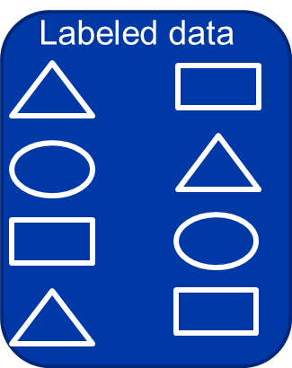

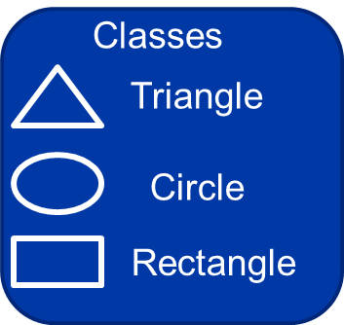
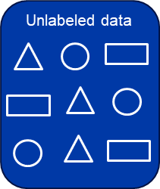



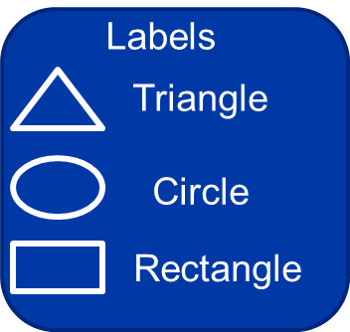
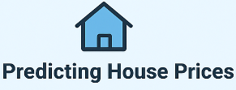
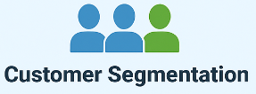
Supervised Learning vs Unsupervised Learning
Machine Learnt Classes
Machine Learnt Groups
Learn
Learn
Predicting house prices based on historical pricing data like Square foot, No. of bedrooms, Location, Age of the house, No. of floors and their price
Group customers into segments to identify high-income/low-frequency, young frequent-purchase, and budget-conscious customers using data such as customer age, annual spend, purchase frequency, and income.
Supervised Learning
Regression
Develop predictive model based on historical input data and resulting output
Semi-Supervised?
Classification
Machine Learning Techniques
Machine Learning
Un-Supervised Learning
Clustering
Group or categorize unlabeled / uncategorized data to derive insight
Association
Dim. Reduction

Slide 4
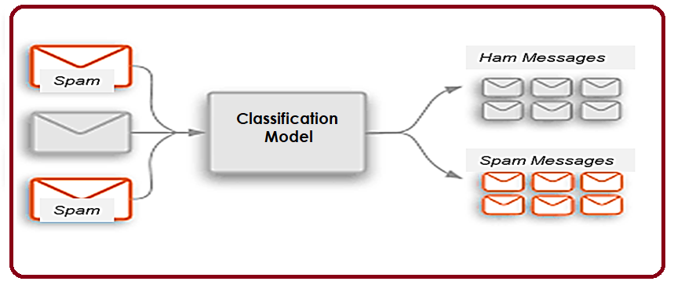
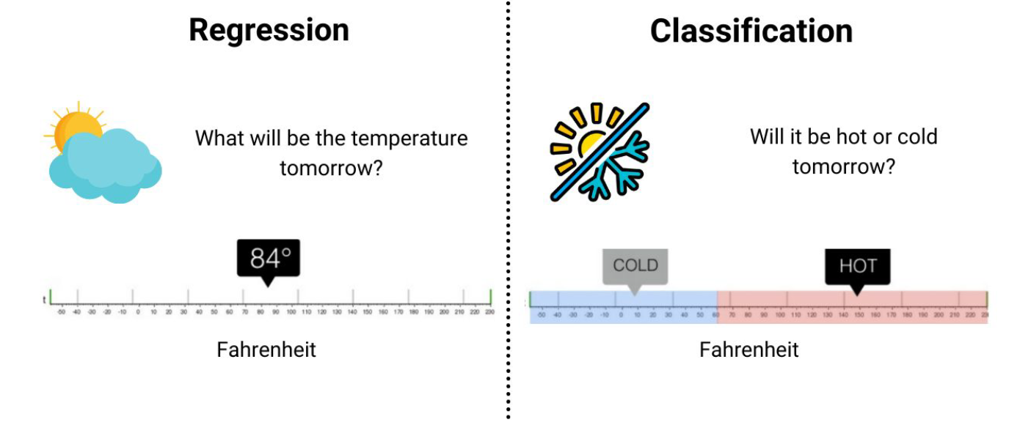
Classification
Classification is defined as the process of recognition, understanding, and grouping of objects and ideas into preset categories. With the help of these pre-categorized training datasets, classification in machine learning programs leverage a wide range of algorithms to classify future datasets into respective and relevant categories.
One of the most common applications of classification is for filtering emails into “spam” or “non-spam”, as used by today’s top email service providers

Slide 5
Classifier
The algorithm which implements the classification on a dataset is known as a classifier. There are two types of Classifications:
Binary Classifier: If the classification problem has only two possible outcomes, then it is called as Binary Classifier.
Multi-class Classifier: If a classification problem has more than two outcomes, then it is called as Multi-class Classifier.
Multi-label Classifier: A multilabel classifier is a model that maps each input instance to a subset of possible labels (one, several, or none)
Classifier
Binary Classifier
Ex: YES or NO, MALE or FEMALE
Multi-class Classifier
Ex: Types of animals
Multi-label Classifier
Ex: movie genres, scientific journals
Carnivore, Herbivore, Omnivore
[Action, Adventure],
[Drama],
[Comedy, Romance]
["Materials Science", "Nanotechnology"]
["Bioinformatics", "Genomics"]
["Machine Learning", "Computer Vision"]
Lazy Learners: Lazy Learner firstly stores the training dataset and wait until it receives the test dataset. In Lazy learner case, classification is done on the basis of the most related data stored in the training dataset. It takes less time in training but more time for predictions.
Eager Learners: Eager Learners develop a classification model based on a training dataset before receiving a test dataset. Opposite to Lazy learners, Eager Learner takes more time in learning, and less time in prediction.
Learners
Lazy Learner
Ex: kNN algorithm, Case-based reasoning
Eager Learner
Ex: Decision Trees, Naïve Bayes

Slide 6
Types of ML Classification Algorithms
Linear Models
Logistic Regression
Support Vector Machines
Non-linear Models
K-Nearest Neighbor
Kernel SVM
Naïve Bayes
Decision Tree Classification
Random Forest Classification
Neural Networks
Linear classifiers make predictions based on a linear combination of the input features.
Nonlinear classifiers can model more complex relationships between features and can produce nonlinear (curved) decision boundaries.

Slide 7
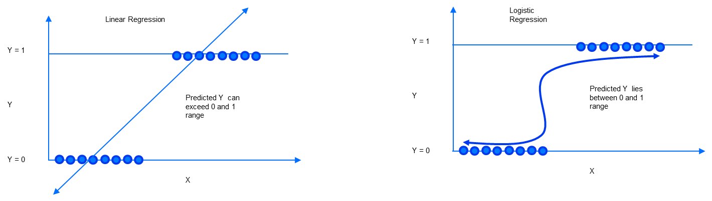
Algorithm 1 - Logistic Regression
Logistic regression is a classification algorithm used to predict a binary outcome: either something happens or does not. This can be exhibited as Yes/No, Pass/Fail, Alive/Dead, etc.
Independent variables are analyzed to determine the binary outcome with the results falling into one of two categories. The independent variables can be categorical or numeric, but the dependent variable is always categorical.

Slide 8


Algorithm 1 - Logistic Regression
Logistic regression models the probability that an event Y=1 occurs given features x using the logistic (sigmoid) function. The sigmoid function is a smooth, S-shaped function that maps any real number to a value between 0 and 1. Note how p(x) is limited between the value of 0 and 1 for all possible values of x
$$p(x)=\frac{1}{1+e^{−(βo+x ∗β)}}$$
Here, $β_{0}$is the intercept, $β$is the coefficients, and $x$ is the feature
With some simple steps we get derive a formulation similar looking to a regression equation. Taking the natural logarithm of the odds yields the log-odds (also called the “logit”)
log-odds
log $\frac{p(x)}{1 −p(x)}=βo+x ∗β$
Odds: It is the ratio of the probability the event happens to the probability it does not happen.
This shows that logistic regression is a linear model on the log-odds scale. The coefficients $β$represent how a unit change in a feature changes the log-odds of the event. We will predict Y = 1 when p ≥ 0.5 and Y = 0 when p < 0.5

Slide 9

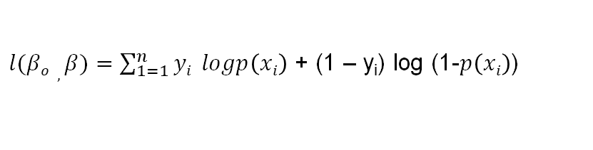


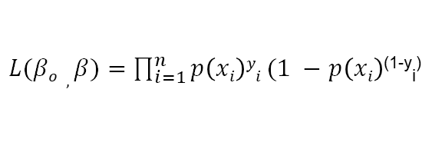




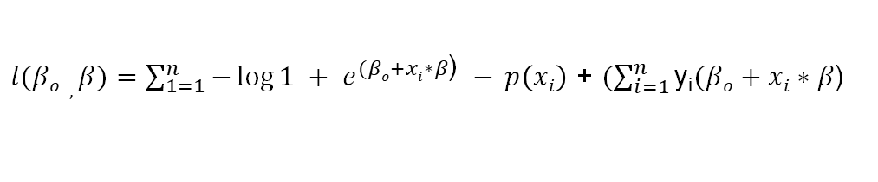

Algorithm 1 - Logistic Regression – contd..
We can get the optimal estimates for the unknown parameters of logistic regression using Maximum Likelihood Estimation
For each training data-point, we have a vector of features, x_{i} , and an observed class, y_{i} . For every sample,
, probability is
if
$$\text{y}\text{i}=1$$
$$p\left(xi\right)$$
if
$$\text{y}\text{i}=0$$
, probability is
$$1 −p\left(xi\right)$$
So, the likelihood for one data point is,
$p\left(xi\right)\text{(}\text{yi}\text{)}(1 −$ $p\left(xi\right)$^{(1-y}_{i}⁾
For all data points (I = 1 to n),
$L(βo , β)=\prod_{i=1}^{n}{p\left(xi\right)yi}(1 −$ $p\left(xi\right)$^{(1-y}_{i}⁾
Take log on both sides and rearrange terms to get the below formulation
$l(βo , β)=$ $\sum_{1=1}^{n}{yi} logp\left(xi\right)$ + (1 – y_{i}) log (1-$p\left(xi\right)$)
substitute
$$p(x)=\frac{1}{1+e^{−(βo+x ∗β)}}$$
$$1 − p(x)=\frac{e^{−(βo+x ∗β)}}{1+e^{−(βo+x ∗β)}}$$
in the above equation
$l(βo , β)=$ $\sum_{1=1}^{n}{−}\log{1 + e^{(βo+xi∗β\text{)}} − }p\left(xi\right)$ + $(\sum_{i=1}^{n}{\text{y}\text{i}(βo+xi∗β\text{)}}$
This is the standard logistic regression log-likelihood. This is the function we maximize to learn the best parameters
$$βo, β$$

Slide 10
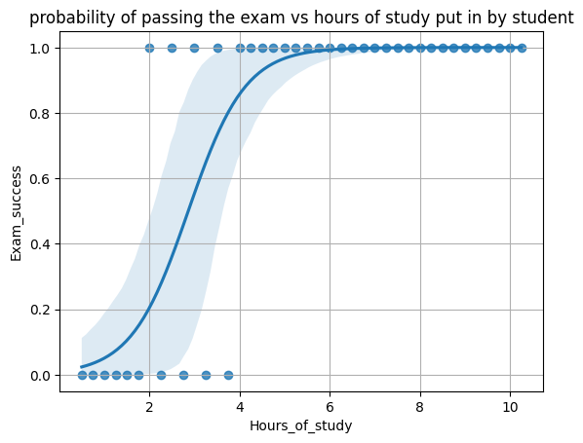

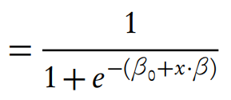
Algorithm 1 - Logistic Regression – contd..
Example: A group of 40 students spends between 0 and 10.5 hours studying for an exam. How does the number of hours spent studying affect the probability of the student passing the exam?
Hours of study | 0.5 | 0.75 | 1 | 1.25 | 1.5 | 1.75 | 2 | 2.25 | 2.5 | 2.75 | 3 | 3.25 | 3.5 | 3.75 | 4 | 4.25 | 4.5 | 4.75 | 5 | 5.25 | 5.5 | 5.75 | 6 | 6.25 | 6.5 | 6.75 | 7 | 7.25 | 7.5 | 7.75 | 8 | 8.25 | 8.5 | 8.75 | 9 | 9.25 | 9.5 | 9.75 | 10 | 10.25
Exam success | 0 | 0 | 0 | 0 | 0 | 0 | 1 | 0 | 1 | 0 | 1 | 0 | 1 | 0 | 1 | 1 | 1 | 1 | 1 | 1 | 1 | 1 | 1 | 1 | 1 | 1 | 1 | 1 | 1 | 1 | 1 | 1 | 1 | 1 | 1 | 1 | 1 | 1 | 1 | 1
Assume that the logistic regression parameters have been derived using techniques discussed earlier, and we have the following estimates of the unknown parameters: β₀= -4.1 and β₁=1.5
Use the Logistic Regression formula to compute the probability of passing p(x) for different hours spent studying (x).
The value of x for which p(x) = 0.5 is ~2.73 hours. It is the decision threshold, so the model would predict “pass” for students who study more than ~2.73 hours and “fail” for students who study less. It is also the inflection point in the logistic curve where the slope is steepest.

Slide 11
Algorithm 2 - Support Vector Machine (SVM)
A support vector machine (SVM) is a supervised machine learning algorithm used for classification and regression, but it is most commonly used for classification.
For a simple visual explanation, we’ll use two tags: red and blue, with two data features: X and Y, then train our classifier to output an X/Y coordinate as either red or blue.
The SVM then assigns a hyper-plane that best separates the regions.
In two dimensions this is simply a line. Anything on one side of the line is red and anything on the other side is blue.
In sentiment analysis, for example, this would be positive and negative.
In order to maximize learning, the best hyper-plane is the one with the largest distance between each region.
Non optimal Hyperplane
Best Hyperplane
Large Margin
Small Margin
SVM tries to maximize the separation between classes by selecting the widest possible margin that separates the training data. Max margin helps with generalization: a larger margin often means better performance on new data.
Linearly Separable regions. In Linear Classification, a hyperplane (w * x) + b = 0 separates the R^{n} in two regions

Slide 12
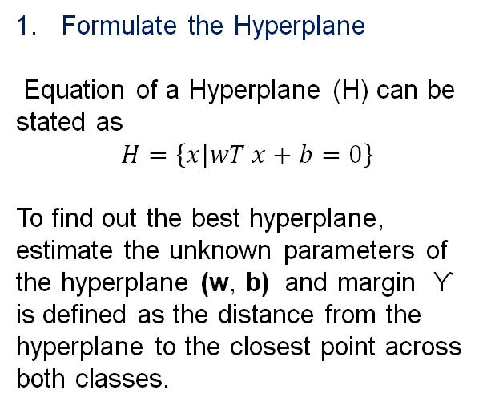

Algorithm 2 - Support Vector Machine (SVM) - Approach
In SVM we try to find a Hyperplane (H) that best separates the datapoints from the two classes.
For a 2 class problem the separator is a line.
Support Vectors Data points that influence the position and orientation of the hyperplane
Formulate the Hyperplane
Equation of a Hyperplane (H) can be stated as
$$H=\left\{x|wT x+b=0\right\}$$
To find out the best hyperplane, estimate the unknown parameters of the hyperplane (w, b) and margin Ƴ is defined as the distance from the hyperplane to the closest point across both classes.
Ƴ
Ƴ
Class B
Upper Support
Sub-optimal Support
Class A
Sub-optimal Support
w
Optimal Hyperplane
Lower Support
Maximum Margin
$$H=\left\{x|wT x+b=0\right\}$$

Slide 13
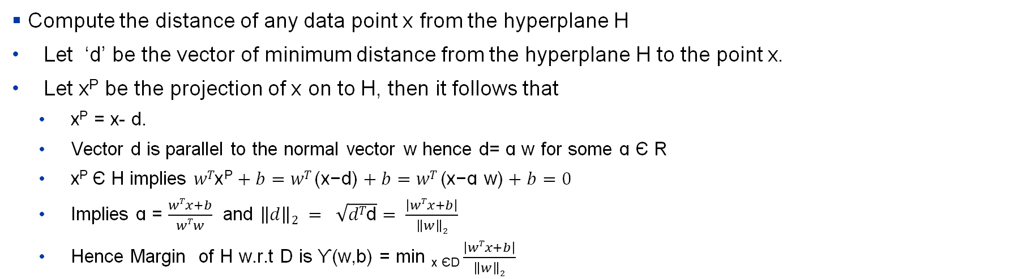
Algorithm 2 - Support Vector Machine (SVM) – contd..
2. Formulate a margin for the hyperplane:
x
Compute the distance of any data point x from the hyperplane H
Let ‘d’ be the vector of minimum distance from the hyperplane H to the point x.
Let x^{P} be the projection of x on to H, then it follows that
x^{P} = x- d.
Vector d is parallel to the normal vector w hence d= ɑ w for some ɑ Є R
x^{P} Є H implies $wT\text{x}\text{P}+b=wT \text{(}\text{x}\text{−}\text{d}\text{)}+b=wT \text{(}\text{x}\text{−ɑ }\text{w}\text{)}+b=0$
Implies $\text{ɑ}$ = $\frac{wTx+b}{wTw}$ and $\left\|d\right\|2 = \sqrt{dT\text{d}}= \frac{\left|wTx+b\right|}{\left\|w\right\|2}$
Hence Margin of H w.r.t D is Ƴ(w,b) = min _{x ЄD} $\frac{\left|wTx+b\right|}{\left\|w\right\|2}$
d
x^{P}
w

Slide 14
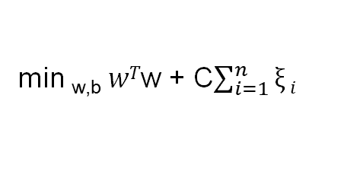





Algorithm 2 - Support Vector Machine (SVM) – contd..
3. Formulate the Cost Function
Cost Function: Look for the hyperplane with maximum separation
max _{w,b} Ƴ(w,b)
Soft Constraint We can allow for slight misclassification by introducing some slack variables in the optimization criteria
min _{w,b} $wT$w + C$\sum_{i=1}^{n}{ξ}i$
Maximize the margin
s.t. $∀iyi(wTxi+b$) ≥ 1 - $ξ i$
Hard Constraint All datapoints to be classified correctly
$∀iyi(wTxi+b$) ≥ 0
s.t. $∀i$ $ξ i$≥ 0
Separating Hyperplane
4. Solve the cost function (Not discussed in Training)
The solution will give the optimal values of the unknown parameters (w, b) of the best separating hyperplane
5. Use the hyperplane to classify new datapoints x_{i}
If
$(wTxi+b$) < 0
then classify x_{i} as Class A
If
$(wTxi+b$) ≥ 0
then classify x_{i} as Class B

Slide 15
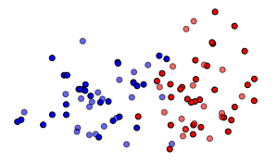
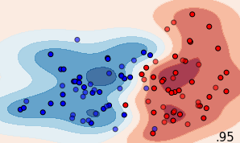


Algorithm 2 - Support Vector Machine (SVM) – contd..
We can’t use the conventional SVM method if the data is not linearly separable
Kernels are used to transform the data to a high dimensional space where they become linearly separable
Some Common Kernels (K)
Polynomial Kernel
Radial Basis Function (RBF)
RBF KERNEL

Slide 16
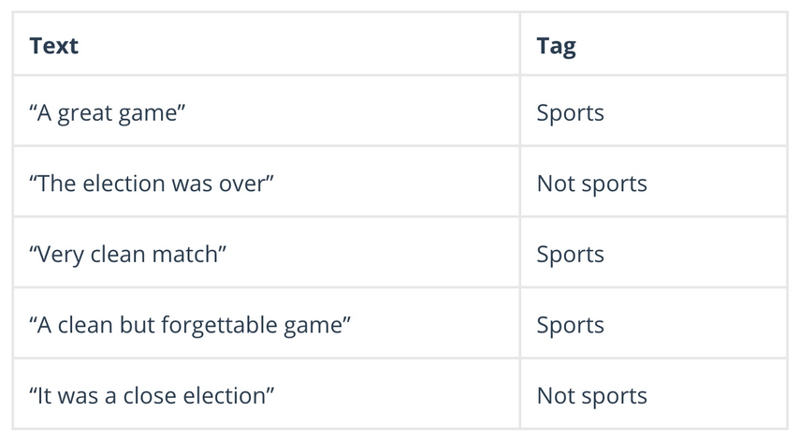
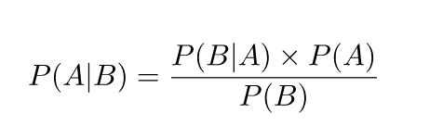
Algorithm 3 - Naïve Bayes
Naïve Bayes is a simple probabilistic classifier based on Bayes’ Theorem with a strong assumption that all features are independent given the class.
Naïve Bayes calculates the possibility of whether a data point belongs within a certain category or does not. In text analysis, it can be used to categorize words or phrases as belonging to a preset “tag” (classification) or not. For example:
To decide whether or not a phrase should be tagged as “sports,” you need to calculate:
* Bayes’ theorem is a fundamental rule in probability that tells us how to update our belief about an event after seeing new evidence.

Slide 17
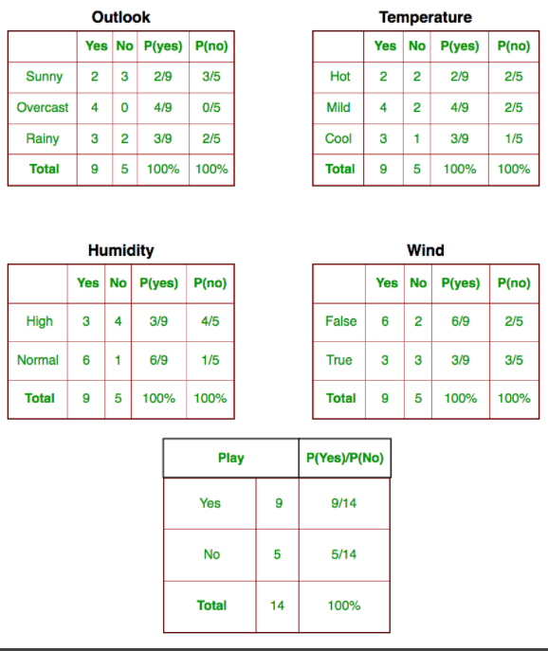
Algorithm 3 - Naïve Bayes – contd..
$$P\left(Yes \right|today)= \frac{P\left(Sunny_Outlook | Yes\right)P\left(Hot_{temperature} | Yes\right)P\left(Normal_{Humidity} | Yes\right)P\left(No_{Wind} | Yes\right)P(Yes)}{P(today)}$$
 | Outlook | Temperature | Humidity | Windy | Play Golf
0 | Rainy | Hot | High | False | No
1 | Rainy | Hot | High | True | No
2 | Overcast | Hot | High | False | Yes
3 | Sunny | Mild | High | False | Yes
4 | Sunny | Cool | Normal | False | Yes
5 | Sunny | Cool | Normal | True | No
6 | Overcast | Cool | Normal | True | Yes
7 | Rainy | Mild | High | False | No
8 | Rainy | Cool | Normal | False | Yes
9 | Sunny | Mild | Normal | False | Yes
10 | Rainy | Mild | Normal | True | Yes
11 | Overcast | Mild | High | True | Yes
12 | Overcast | Hot | Normal | False | Yes
13 | Sunny | Mild | High | True | No
Step 1: Convert the data set to the frequency table
Step 2: Create a Likelihood table by finding the probabilities
Step 3: Now, use the Naive Bayesian equation to calculate the posterior probability for each class. The class with the highest posterior probability is the outcome of the prediction.
P(temp. = cool | play golf = Yes) = 3/9

Slide 18
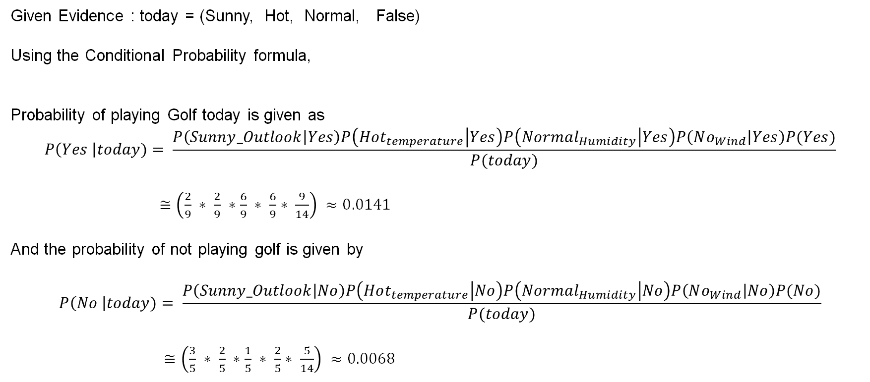
Algorithm 3 - Naïve Bayes – contd..
Given Evidence : today = (Sunny, Hot, Normal, False)
Using the Conditional Probability formula,
Probability of playing Golf today is given as
$$P\left(Yes \right|today)= \frac{P\left(Sunny_Outlook | Yes\right)P\left(Hot_{temperature} | Yes\right)P\left(Normal_{Humidity} | Yes\right)P\left(No_{Wind} | Yes\right)P(Yes)}{P(today)}$$
$≅\left(\frac{2}{9} ∗ \frac{2}{9} ∗\frac{6}{9} ∗ \frac{6}{9}∗ \frac{9}{14}\right) ≈0.0141$
And the probability of not playing golf is given by
$$P\left(No \right|today)= \frac{P\left(Sunny_Outlook | No\right)P\left(Hot_{temperature} | No\right)P\left(Normal_{Humidity} | No\right)P\left(No_{Wind} | No\right)P(No)}{P(today)}$$
$≅\left(\frac{3}{5} ∗ \frac{2}{5} ∗\frac{1}{5} ∗ \frac{2}{5}∗ \frac{5}{14}\right) ≈0.0068$
The class with the highest posterior probability is the outcome of the prediction. Here ‘Playing Golf today’ has higher probability, hence it is the prediction.

Slide 19
Algorithm 4 - k-Nearest Neighbors (KNN)
Let us try to classify the grey point given 3 classes marked with respective colors
The KNN algorithm assumes that similar things exist in close proximity. In other words, similar things are near to each other.
“Birds of a feather flock together.”
Step 1: Visualize the data given the input vector
Step 2: Compute the distance from each point in the vector space
x₂
x₂
2.4
2.1
3.2
Step-1: Calculate the distances of test point to all points in the training set and store them
Step-2: Sort the calculated distances in increasing order
Step-3: Store the K nearest points from our training dataset
Step-4: Calculate the proportions of each class
Step-5: Assign the class with the highest proportion
5.0
x₁
x₁
3 classes – Yellow, Blue and Red
Step 3: Rank the closest neighbors
Step 4: Vote on labels. Identify class to which this point belongs
2
x₂
1
x₂
2.1
5.2
2.1
5.2
1.8
1.8
3.0
3.0
1
x₁
x₁

Slide 20
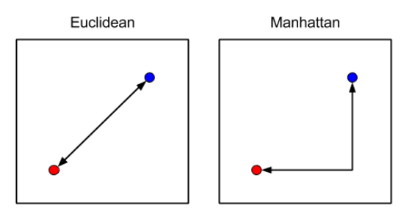
Algorithm 4 - k-Nearest Neighbors (KNN) – contd..
We can calculate the distances between points in KNN using different distance metrics. Two common distance metrics – Euclidean and Manhattan are given below
Euclidean distance is the straight-line distance between two points in space.
Manhattan distance is another way to measure distance between two points. Instead of a straight line, it measure the distance like you move in a grid (up / down / left / right)
Problem:
Calculate Euclidean and Manhattan distances between
a. (1, 2) and (5,9)
b. (1,2,1) and (5, 9, 2)
d = sqrt((x2-x1)^2 + (y2-y1)^2)
Euclidean:
Sqrt( (5-1)^2 + (9-2)^2 )
= sqrt(16 + 49)
= Sqrt(65) = 8.06
Manhattan:
|x1-x2| + |y1-y2|
= 11
Euclidean distance - continuous smooth data
Manhattan distance – discrete, grid-like or high dimensional data

Slide 21
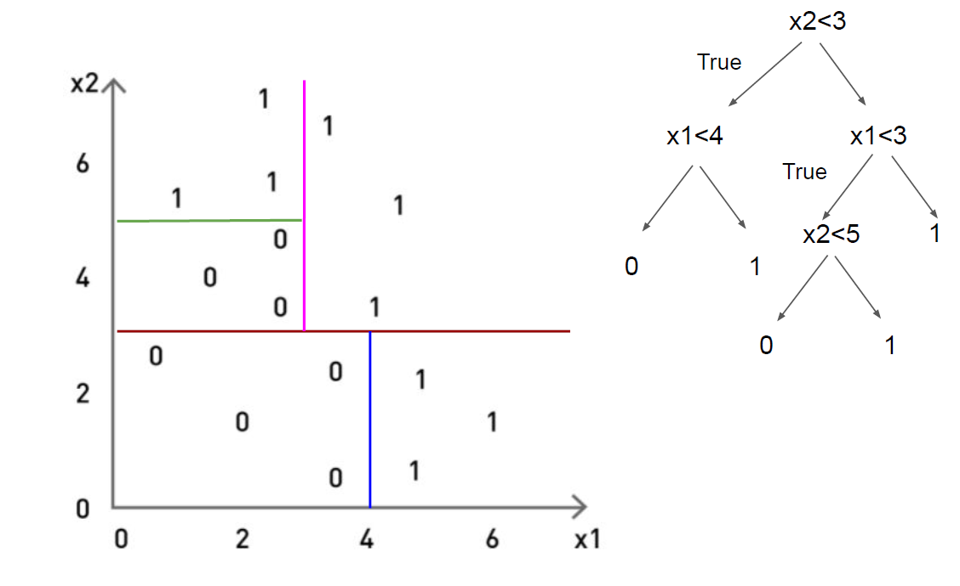
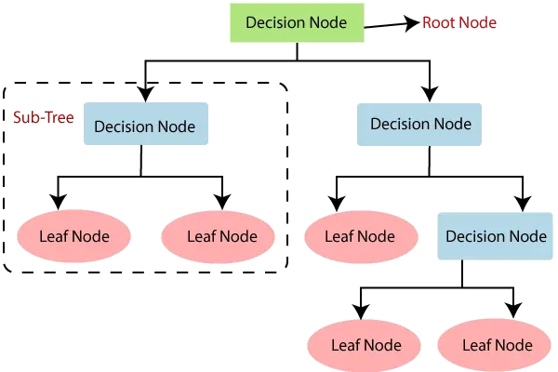
Algorithm 5 – Decision Tree
Decision tree is a supervised learning algorithm that is perfect for classification problems, as it’s able to order classes on a precise level.
A decision tree is a visual representation of decision-making processes. It resembles a flowchart with nodes and branches, where each node represents a decision or an event and each branch represents an outcome or a possible path.

Slide 22
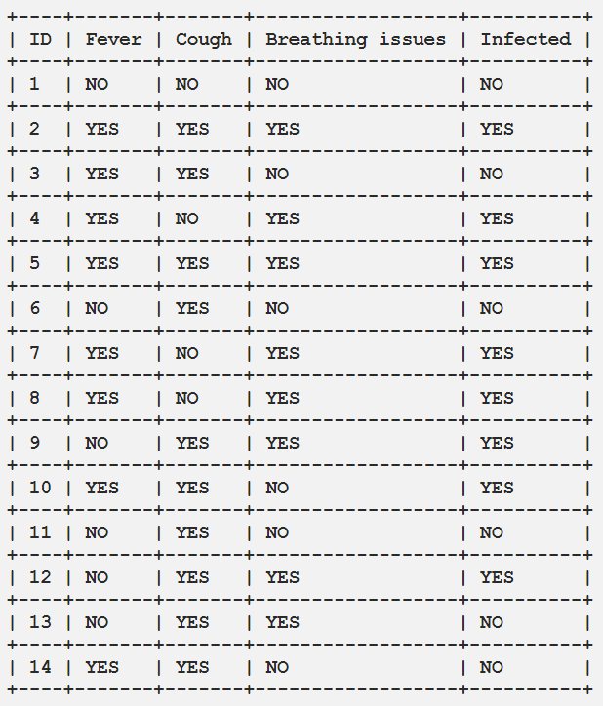
Algorithm 5 – Decision Tree – contd..
Building a Decision Tree
Entropy A measure of the impurity or randomness of a dataset
If all samples in the dataset belongs to same class – no uncertainty
If classes are mixed equally – maximum uncertainty
Decision Tress prefer splits that reduce uncertainty to the most
Information Gain – measure how much entropy decreases after a dataset is split using a feature
(IG) = Entropy (before split) – Entropy (after split)
In decision tress, we want to pick the attribute that best separate the classes. If information gain is higher, the split is useful and helps separate classes.
Complete Dataset

Slide 23
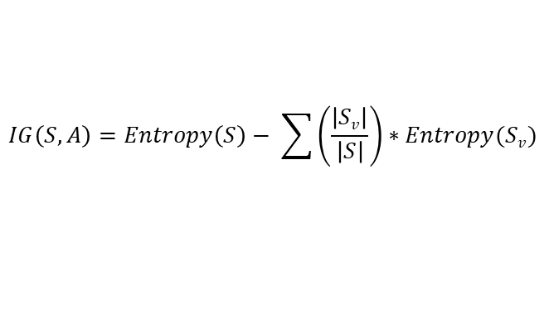
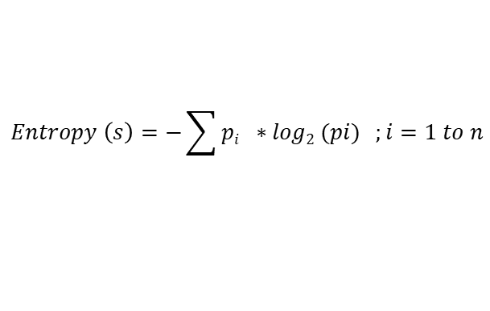
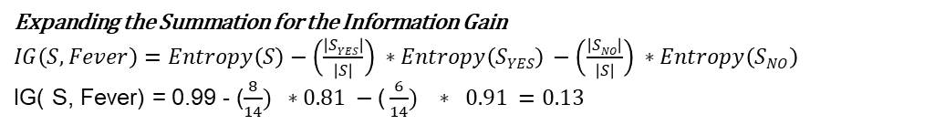
Algorithm 5 – Decision Tree – contd..
$$Entropy \left(s\right)=−\sum{pi ∗log2 (pi)} ;i=1 to n$$
Computing Information Gain for Feature - Fever
$$IG\left(S, A\right)=Entropy\left(S\right)− \sum{\left(\frac{\left|Sv\right|}{\left|S\right|}\right)∗Entropy(Sv})$$
Fever | Cough | BreathingIssues | Infected
YES | YES | YES | YES
YES | YES | NO | NO
YES | NO | YES | YES
YES | YES | YES | YES
YES | NO | YES | YES
YES | NO | YES | YES
YES | YES | NO | YES
YES | YES | NO | NO
Fever | Cough | Breathing Issues | Infected
NO | NO | NO | NO
NO | YES | NO | NO
NO | YES | YES | YES
NO | YES | NO | NO
NO | YES | YES | YES
NO | YES | YES | NO
$For v=NO, \left|Sv\right|=6, Entropy (Sv$) = - ($\frac{2}{6}) ∗\log{\frac{2}{6}}$ - $\frac{4}{6}$ $\log_{2}{\frac{4}{6} =0.91}$
$For v=YES, \left|Sv\right|=8, Entropy (Sv$) = - ($\frac{6}{8}) ∗\log_{2}{\frac{6}{8}}{}$ - $\frac{2}{8}$ $\log_{2}{\frac{2}{8} =0.81}$
Expanding the Summation for the Information Gain
$IG\left(S, Fever\right)=Entropy\left(S\right)−\left(\frac{\left|SYES\right|}{\left|S\right|}\right) ∗Entropy\left(SYES\right) −\left(\frac{\left|SNO\right|}{\left|S\right|}\right) ∗Entropy\left(SNO\right)$
IG( S, Fever) = 0.99 - ($\frac{8}{14}) ∗0.81 −\text{(}\frac{6}{14}) ∗ 0.91 =0.13$

Slide 24
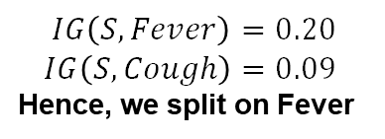
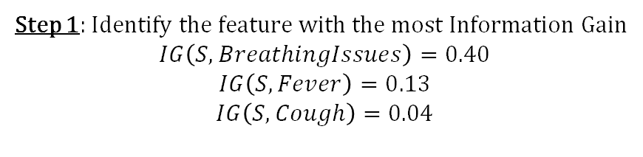
Algorithm 5 – Decision Tree – contd..
Step 1: Identify the feature with the most Information Gain
$$IG\left(S, BreathingIssues\right)=0.40$$
$$IG\left(S, Fever\right)=0.13$$
$$IG\left(S, Cough\right)=0.04$$
Feature with Highest Information Gain
Breathing Issue
NO
YES
Step 2: Now for BreatingIssues = YES
Fever
Cough
Fever | Cough | Breathing Issues | Infected
YES | YES | YES | YES
YES | NO | YES | YES
YES | YES | YES | YES
YES | NO | YES | YES
YES | NO | YES | YES
NO | YES | YES | YES
NO | YES | YES | YES
NO | YES | YES | NO
$$IG\left(S, Fever\right)=0.20$$
$$IG\left(S, Cough\right)=0.09$$
Hence, we split on Fever
YES
YES
NO
Step 4 As cough is the only feature left
NO
Step 3: Splitting on Fever given BreatingIssues = YES
Fever | Cough | Breathing Issues | Infected
YES | YES | YES | YES
YES | NO | YES | YES
YES | YES | YES | YES
YES | NO | YES | YES
YES | NO | YES | YES
Fever | Cough | Breathing Issues | Infected
NO | YES | YES | YES
NO | YES | YES | YES
NO | YES | YES | NO
Infected
Not Infected
Infected
Not Infected
Build the complete tree

Slide 25
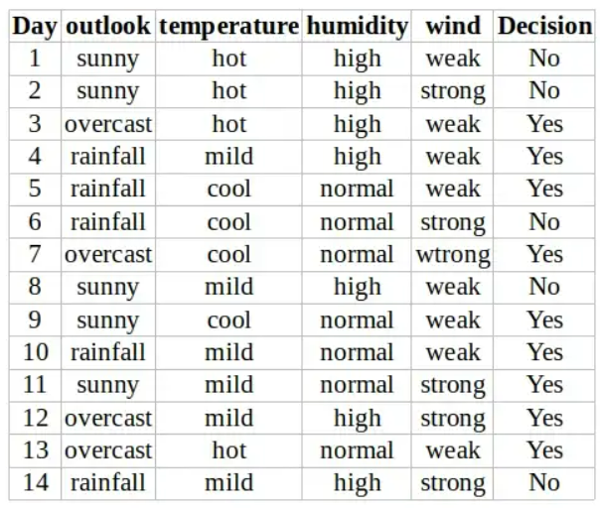
Constructing a Decision Tree
Features
Label
Tree
Sunny
Outlook
Rainfall
Normal
Humidity
High
Overcast
Strong
Wind
Weak
Yes
No
Yes
Yes
No
Decision Tree formulated based on the Training Data
Training Dataset

Slide 26
Algorithm 6 - Random Forest
The random forest algorithm is an expansion of decision tree, in that you first construct a multitude of decision trees with training data, then fit your new data within one of the trees as a “random forest.”
It, essentially, averages your data to connect it to the nearest tree on the data scale. Random forest models are helpful as they remedy for the decision tree’s problem of “forcing” data points within a category unnecessarily.

Slide 27
Algorithm 6 - Random Forest – contd..
Each tree is trained with a subset of the original dataset. Class distribution is maintained in each subset
Each tree is trained based on a random set of features from the original dataset. This is done to avoid enormous computation, and reduce overfitting
Final decision is based on majority voting
X Dataset
N₁ features
N₂ features
N₃ features
N_{n} features
TREE #1
TREE #2
TREE #3
TREE #4
CLASS C
CLASS D
CLASS B
CLASS C
MAJORITY VOTING
FINAL CLASS

Slide 28
Algorithm 6 - Random Forest – contd..
Tuning Parameters
n_estimators– number of trees the algorithm builds before averaging the predictions.
max_features– maximum number of features random forest considers splitting a node.
mini_sample_leaf– determines the minimum number of leaves required to split an internal node.
n_jobs– it tells the engine how many processors it is allowed to use. If the value is 1, it can use only one processor but if the value is -1 there is no limit.
random_state– controls randomness of the sample. The model will always produce the same results if it has a definite value of random state and if it has been given the same hyperparameters and the same training data.
oob_score – OOB means out of the bag. It is a random forest cross-validation method. In this one-third of the sample is not used to train the data instead used to evaluate its performance. These samples are called out of bag samples.

Slide 29
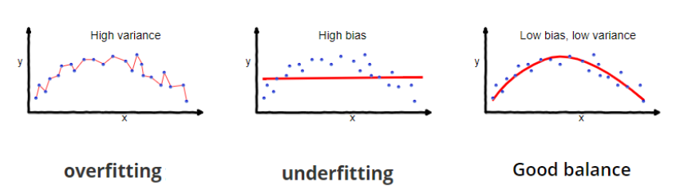
Bias-Variance Tradeoff
Bias is the difference between the average prediction of our model and the correct value which we are trying to predict. Model with high bias pays very little attention to the training data and oversimplifies the model. It always leads to high error on training and test data.
Variance is the variability of model prediction for a given data point or a value which tells us spread of our data. Model with high variance pays a lot of attention to training data and does not generalize on the data which it hasn’t seen before. As a result, such models perform very well on training data but has high error rates on test data.
Underfitting happens when a model unable to capture the underlying pattern of the data. These models usually have high bias and low variance. It happens when we have very less amount of data to build an accurate model or when we try to build a linear model with a nonlinear data.
Overfitting happens when our model captures the noise along with the underlying pattern in data. It happens when we train our model a lot over noisy dataset. These models have low bias and high variance.

Slide 30
Bias-Variance Tradeoff – contd..
Low Variance
High Variance
Underfitting
High Bias
Bias
Truth
Low Bias
Overfitting
Variance

Slide 31
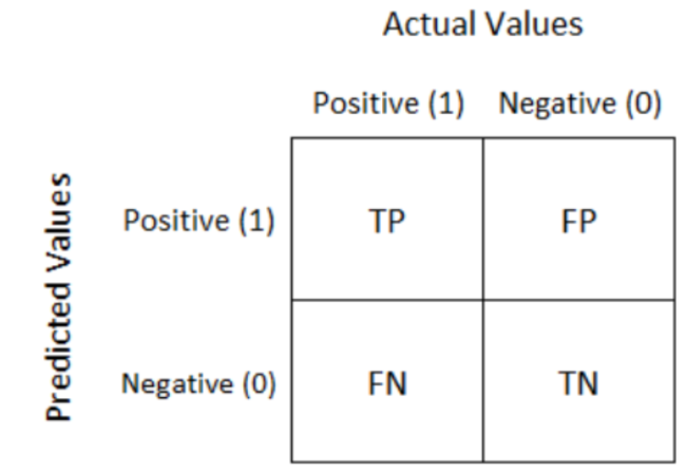
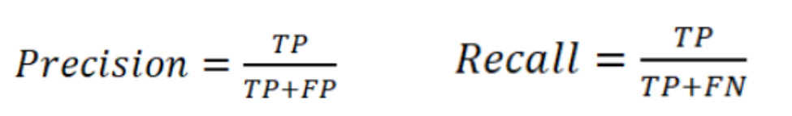

Performance Metrics
Confusion Matrix
Confusion Matrix is a summary of predicted results in specific table layout that allows visualization of the performance measure of the machine learning model
Accuracy - How often is the model right?
Accuracy is the simple ratio between the number of correctly classified points to the total number of points = (TP + TN) / (TP+FP+FN+TN)
Precision - When the model says X, how often is it really X?
It is the fraction of the correctly classified instances from the predicted classified instances.
Recall - Of all real X cases, how many did the model catch?
It is the fraction of the correctly classified instances from the actual classified instances

Slide 32
Performance Metrics
When the dataset is having imbalanced classes, do not use accuracy for reporting
Cancer detection: If 95% patients are healthy and only 5% have cancer and if the model predicts healthy for everyone, the accuracy of the model may be 95% but it is useless as it is not detecting cancer.
Prioritize precision when false positives are more harmful or costly than false negatives
Spam Email detection:
False Positive: Marking a real email as spam. This is harmful because the user may miss important messages.
Cancer Diagnosis:
False Positive: Telling someone that they may have cancer when they actually don’t.
Prioritize recall when false negatives are more harmful or costly than false positives
Airport Security / Weapons detection
False Negative: When a weapon or explosive goes undetected. Extremely dangerous.
Frad Detection:
False Negative: a real fraudulent transaction is missed. Leads to financial losses.

Slide 33
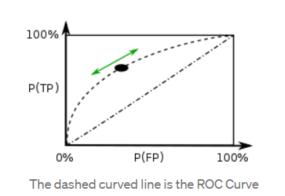
Performance Metrics – contd..
ROC
A Receiver Operating Characteristic curve or ROC curve is created by plotting the True Positive (TP) against the False Positive (FP) at various threshold settings.
The area under the ROC curve (ROC AUC) is the single-valued metric used for evaluating the performance. The higher the AUC, the better the performance of the model at distinguishing between the classes

Slide 34
Aviation related use cases
Flight Delay prediction – open source dataset are available for practice
Boeing projects - discussion

